Slide 1
Front-End Developer 22 – 30.03.2018
Sinisa Vrhovac

Slide 2
Sadržaj časa
CSS

Slide 3
Današnje teme
CSS frameworks
Bootstrap

Slide 4
CSS Frameworks

Slide 5
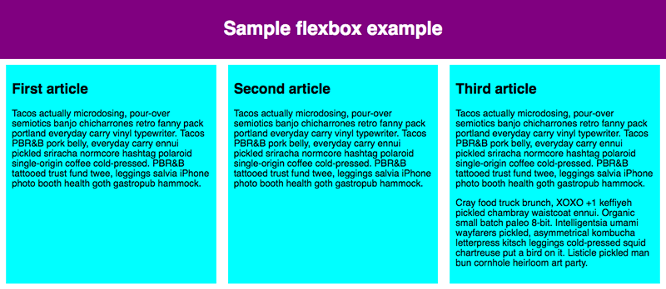
Design grid

Slide 6
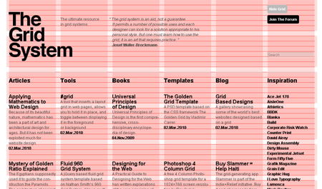
Izdavaštvo

Slide 7
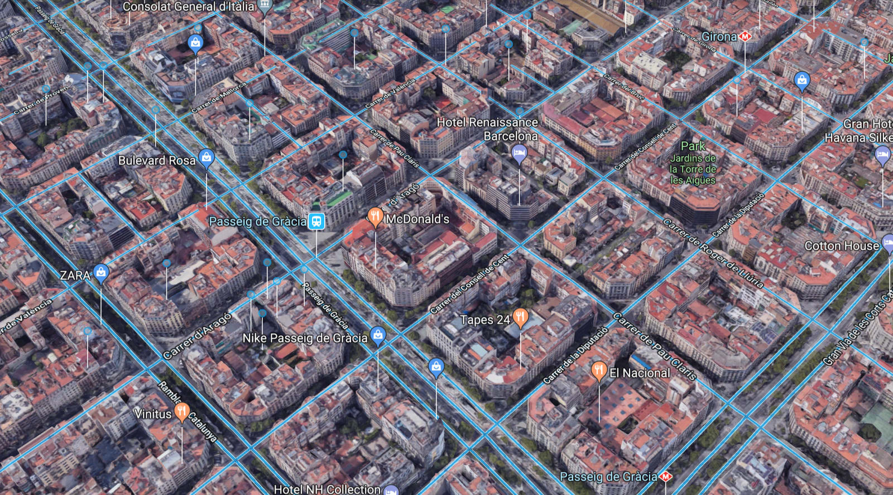
Arhitektura

Slide 8
Grid

Slide 9
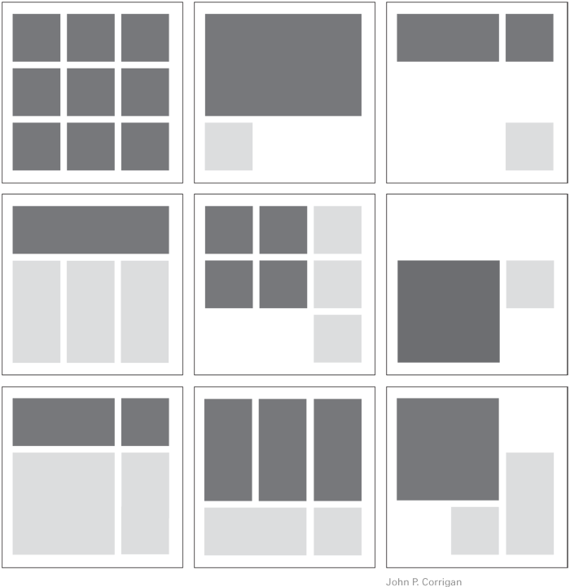
Grid

Slide 10
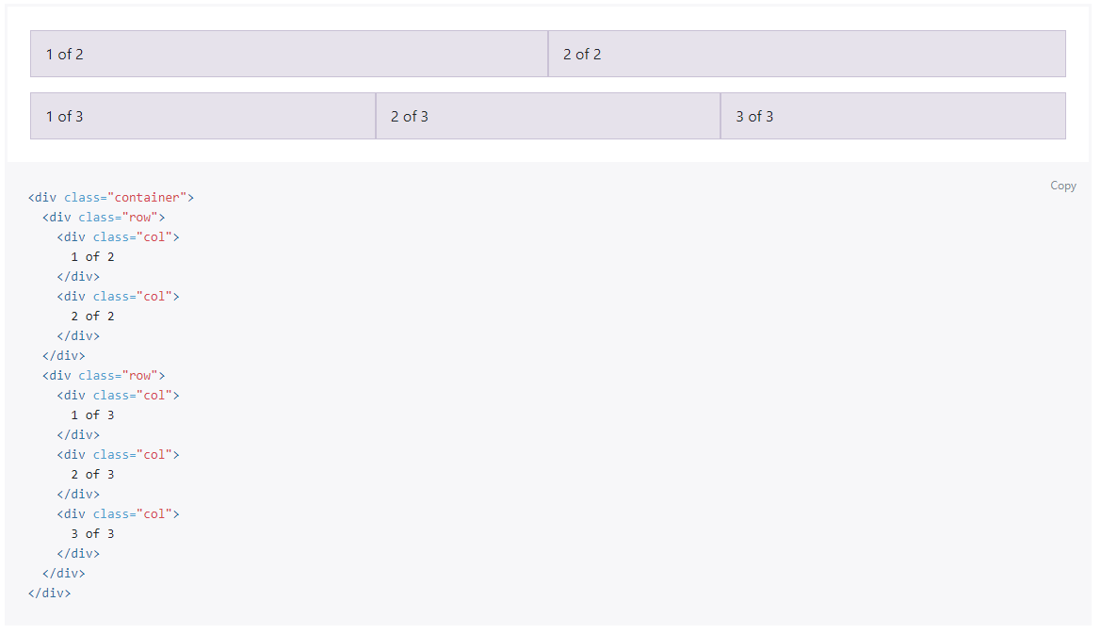
Design grid

Slide 11
Design grid
http://getbootstrap.com/docs/4.0/examples/grid/
http://getbootstrap.com/docs/4.0/examples/jumbotron/
http://getbootstrap.com/docs/4.0/examples/starter-template/
http://getbootstrap.com/docs/4.0/examples/checkout/

Slide 12
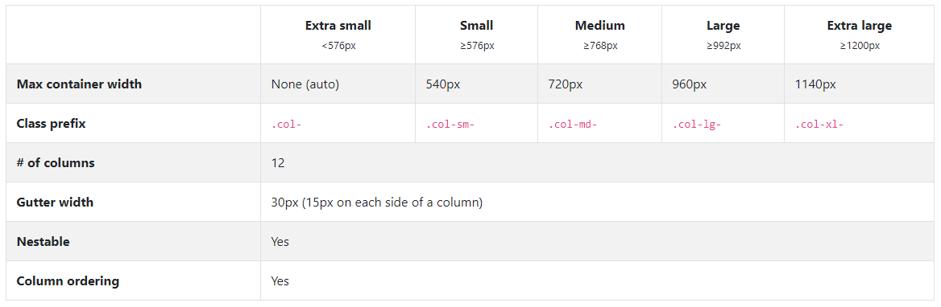
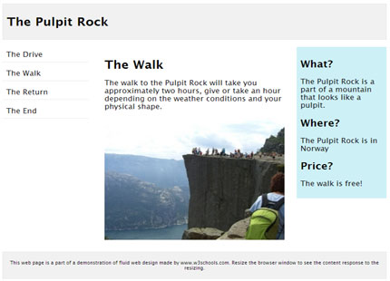
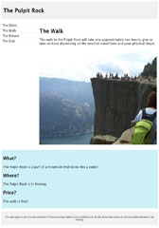

Bootstrap responsive

Slide 13
Vežbe

Slide 14
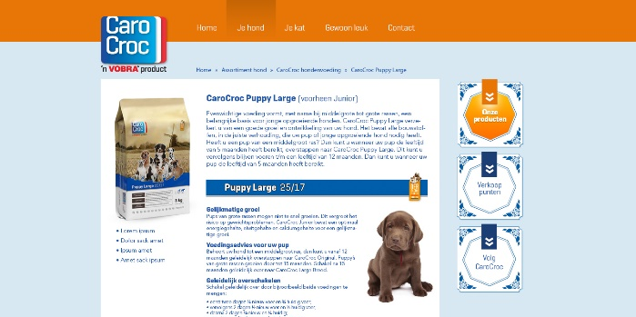
Vežba 1

